Slide 1
Coupon Page for Matrimonial Website

Slide 2
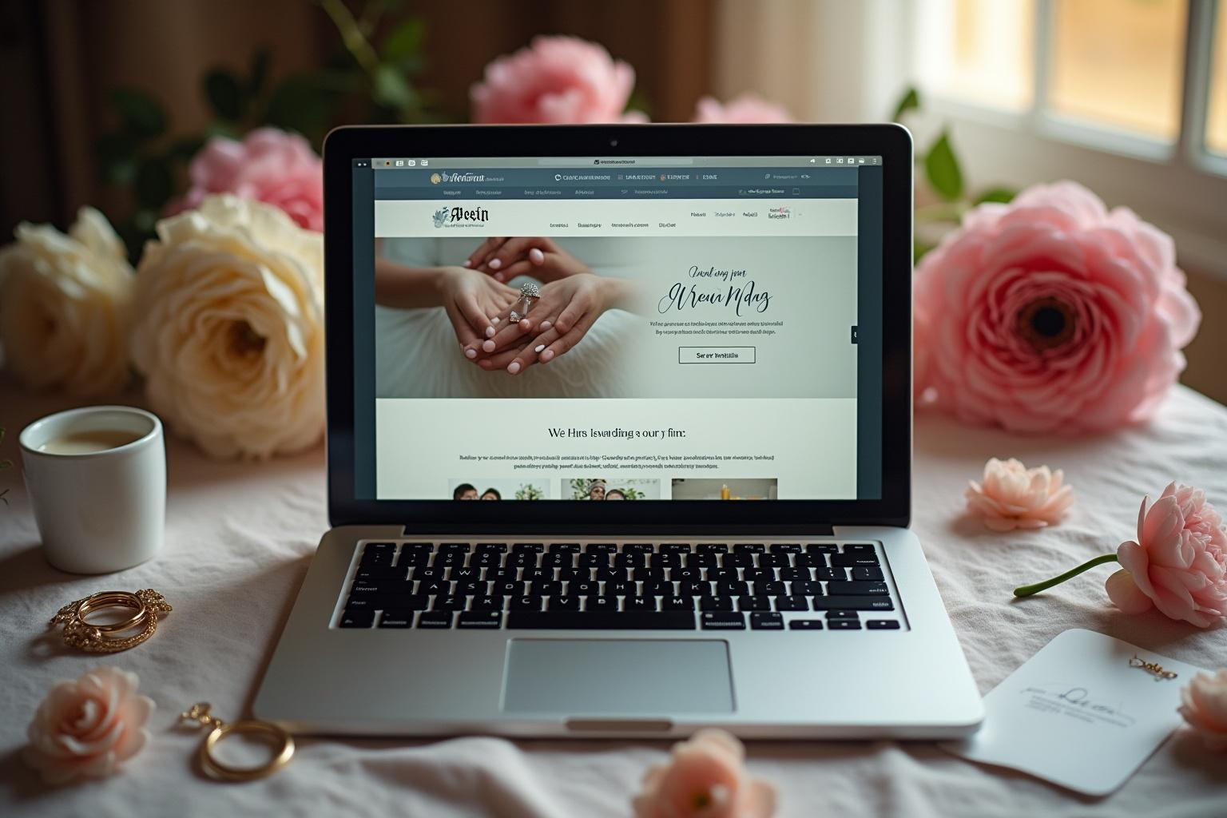
Introduction
The Coupon Page is a responsive web application that allows users to browse, favorite, and redeem discount coupons for various matrimonial services.

Slide 3
Introduction to Coupon Page
The Coupon Page offers an efficient way for users to access and manage discount coupons. It features a modern design and intuitive navigation to enhance user experience.

Slide 4
Technologies Used
This application is developed using React and Vite for the frontend, with CSS for styling. It incorporates React Hooks for state management, ensuring a fast and responsive performance.

Slide 5
Main Features
The Coupon Page includes tab-based navigation for easy browsing of all coupons and favorites, a detailed view for each coupon, and a user-friendly favorite system. Users can copy coupon codes to clipboard and enjoy a mobile-friendly design.

Slide 6
Navigating Coupons
Users land on the Coupon Page, which displays two tabs: 'All Coupons' and 'Favorites'. Coupons are shown as cards, allowing for a straightforward browsing experience.

Slide 7
Interacting with Favorites
Users can click the heart icon to add or remove coupons from their favorites list. This feature allows for personalized coupon management, enhancing user engagement.

Slide 8
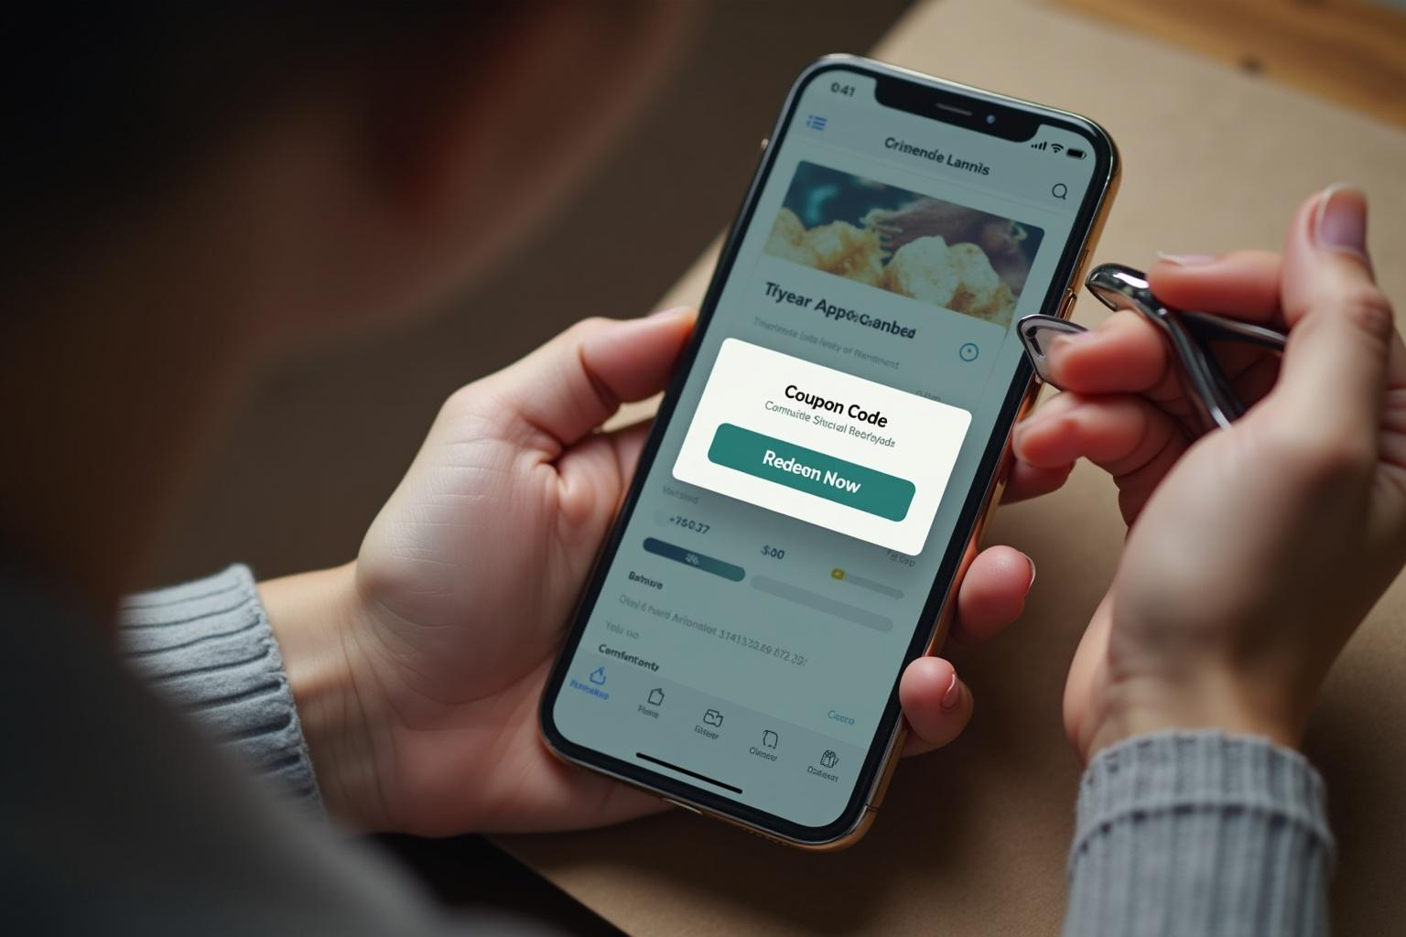
Redeeming Discounts
To redeem a coupon, users click 'Redeem Now', triggering a popup with a coupon code. The 'Copy' button copies the code to the clipboard, ensuring a seamless redemption process.

Slide 9
Conclusion
The Coupon Page delivers a streamlined experience for users to discover and redeem discounts effectively while maintaining an intuitive and responsive design.

